Slide 1
Course Title:
Artificial Intelligence and Expert Systems Lab.
Name: Anowar Hossen Farvez
ID: 20201059
Section: A2

Slide 2
Problem statement:
Implement a basic family relationship tree structure of own family using Prolog. Write rules against degree and removal for up to 3rd degree and twice removed situations.

Slide 3
Tools Used:
1. Draw.io
2. Notepad++
3. SWI-Prolog

Slide 4
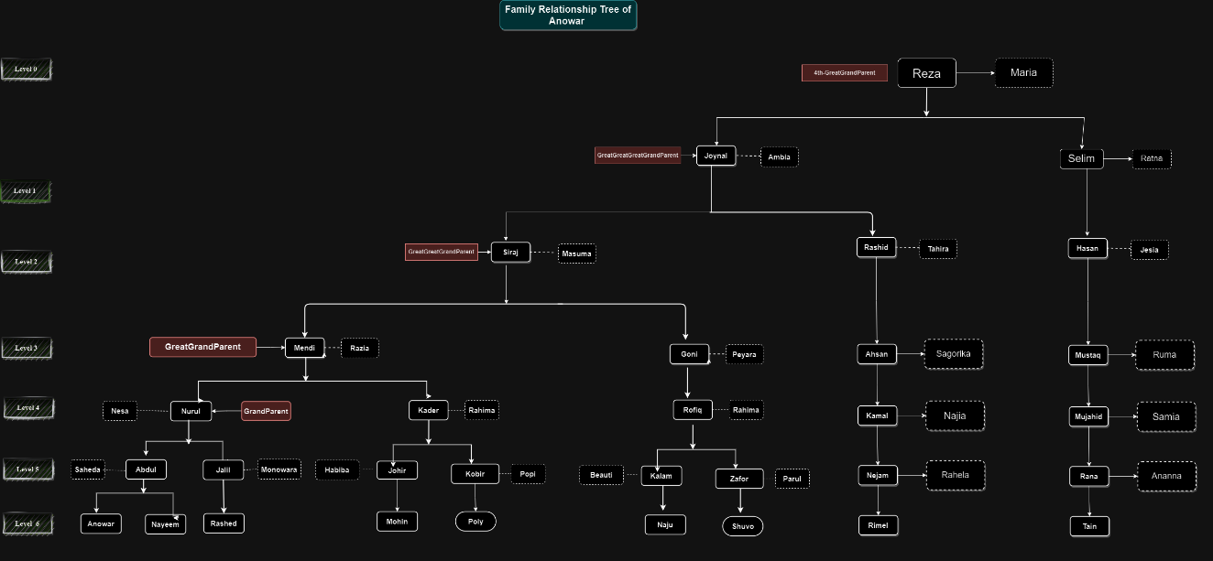
Diagram:

Slide 5
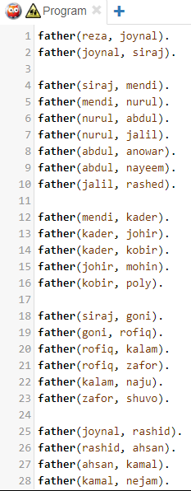
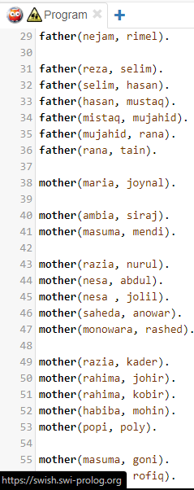
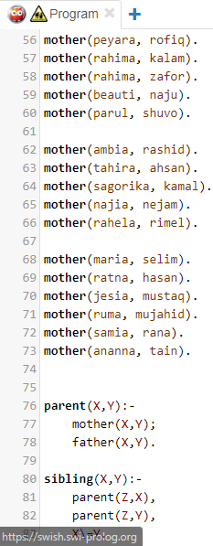
Source Code:

Slide 6
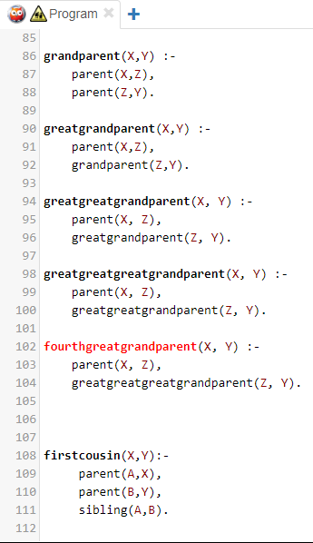
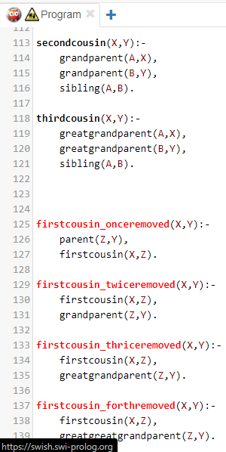
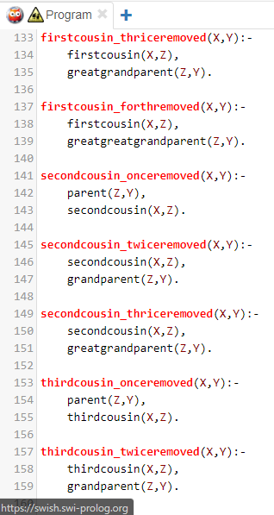
Source Code:

Slide 7
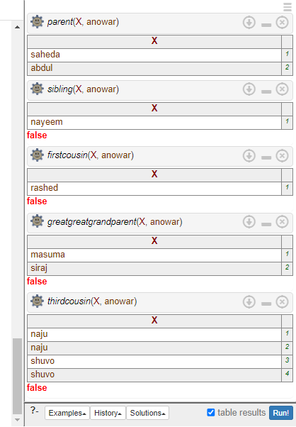
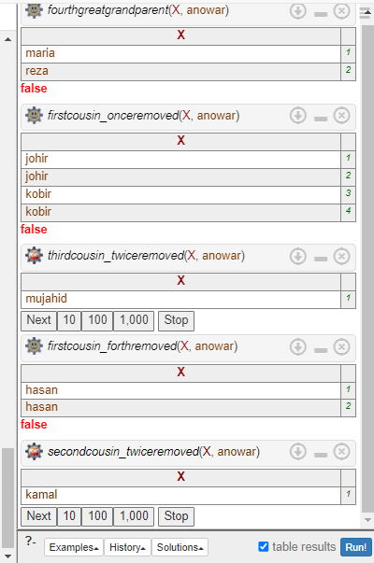
Output:

Slide 8
Conclusion:
I’ve faced some minor difficulties during completing this assignment. SWI-Prolog was showing some errors. But after some troubleshooting I was able to fix all the errors of SWI-Prolog by using google and other sources.

Slide 9
Thank You!

